Slide 1
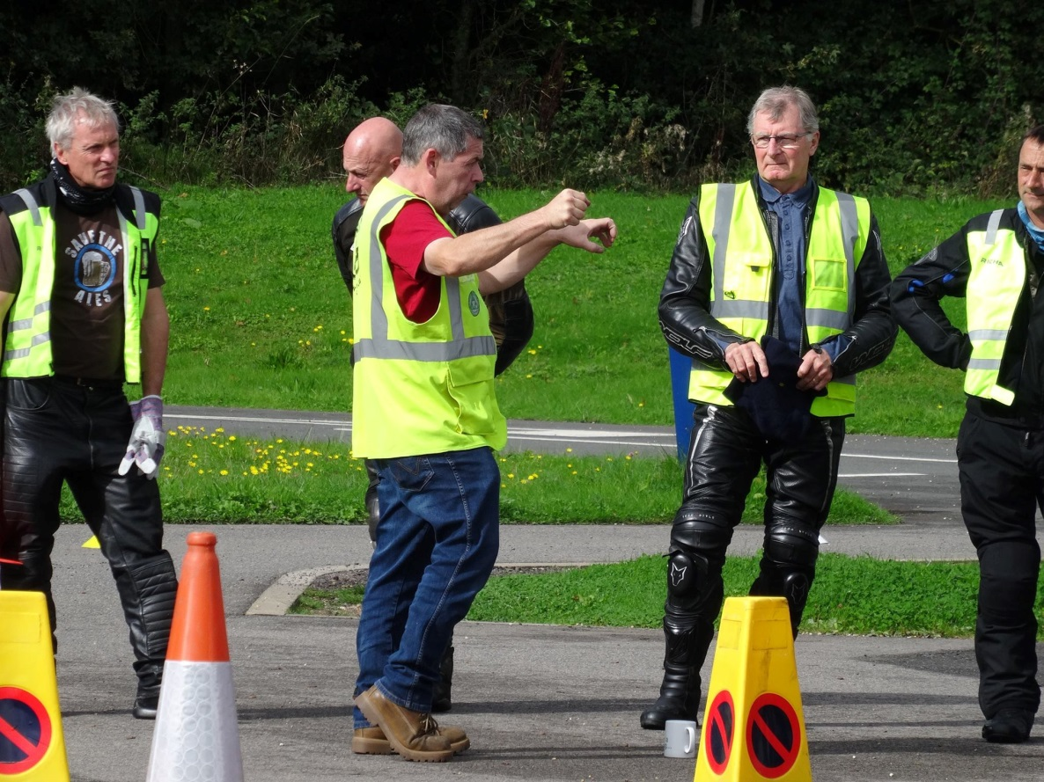
Learning Styles

Slide 2
Learning Styles
Activist
Reflector
Theorist
Pragmatist

Slide 3
Learning Styles
Activist +
Ready to have a go
Like new experiences
In at the deep end
Activist –
Rules
Lectures
Analysis

Slide 4
Learning Styles
Reflector +
Time to think about learning new skills
Carry out research
No pressure or tight guidelines
Reflector–
Forced into the limelight
Rushing from task to task
Not being able to review learning

Slide 5
Learning Styles
Theorist +
Systems, concepts theories (IPSGA)
Time to analyse complex situations
A chance to question basic methology
Theorist –
Made to do something without explanation
Gimmicks
Fun and spontaneity

Slide 6
Learning Styles
Pragmatist +
Need to see a practical advantage
Like to try things with feedback from trainer
Link between theory and practical themes
Pragmatist –
No immediate benefit from training
Lack of clear guidelines
Insufficient reward of skills

Slide 7
Active Listening
How to engage with others

Slide 8
Objectives
Be able to describe the elements of active listening.
Have explored the barriers that can prevent us from listening.
Be aware of the importance of consciously putting our own prejudices and assumptions aside to listen to others

Slide 9
Listening is not the same as hearing

Slide 10
What Stops us from Listening?
Our own experiences
Our own prejudices
Our own state of mind
Time
Environmental factors

Slide 11
Listening Tools
So you have been riding for 10 years
You don’t like wet weather
You would like to improve your riding
You say that you don’t like wet weather – why is that?
When you said that you would like to improve your riding, what areas would these be?
It’s good to hear that you want to improve your skills
Yes….
Good….
Fantastic!...
STFU
Who?
What?
Why?
When?
How?
Where?
Reacting
Open questions
Silence
Encouragement
Summarising
Clarifying
Reflecting

